Slide 1

UC Berkeley FinTech Bootcamp
Deciphering the Dance:
The Correlation between BTC & our stock Portfolio
Lulu Ma
Wilson Qin
German Romero
Kimberly Rodriguez
Notes:
Speaker: Phillip

Slide 2

Titan Capital Management
Titan Capital Management
Motivation & Summary
Hypothesis: can a Stock portfolio Track the performance of Bitcoin potentially capturing substantial returns without direct investment in BTC itself?
Q1:
Can we make a portfolio that mimics and even beats BTC?
Q2:
How does the portfolio perform against BTC?
Q3:
Can BTC be a leading indicator?
2
Notes:
Potential Questions:
Can BTC be a leading indicator?
Will the lack of regulation on BTC play a role in our analysis, and if so, how or what role?
How do we create an active trading strategy?
What is the correlation between the stocks and BTC?
What is the Beta and Sharpe ratio between the stocks and BTC?
How does the portfolio perform against BTC?

Slide 3
Titan Capital Management
Titan Capital Management
Questions & Data
A1:
Yes, but some adjustments had to be made
A2:
Similar average returns & slightly outperformed BTC
A3:
Yes, but only in the short term; a week or less
Weekly Discussion
November 3rd, 2022
3
Notes:
Speaker: Phillip

Slide 4
Titan Capital Management
Titan Capital Management
Data Cleanup & Exploration
Filter using median volume of the entire stock market
Deal with unexpected nulls
Weekly Discussion
November 3rd, 2022
Find the distribution metrics of correlation, Beta, and Sharpe ratio
Split resulting stocks into 3 correlation segments & create a portfolio for each
4

Slide 5
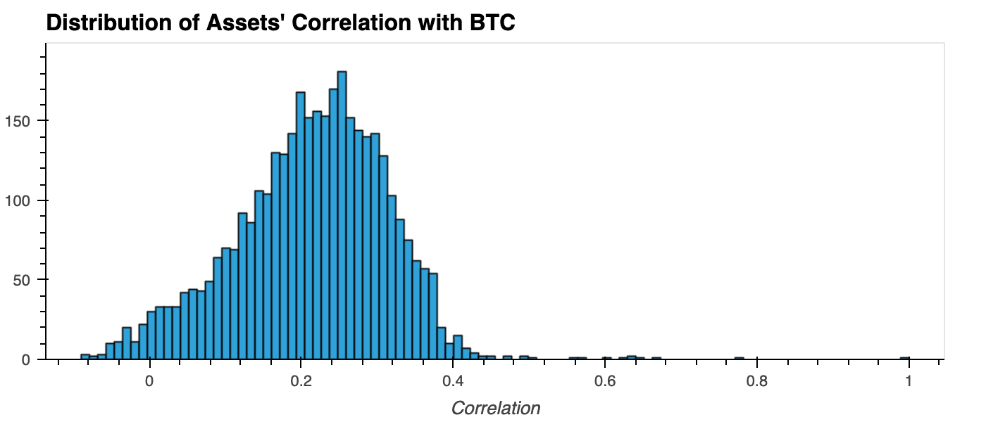
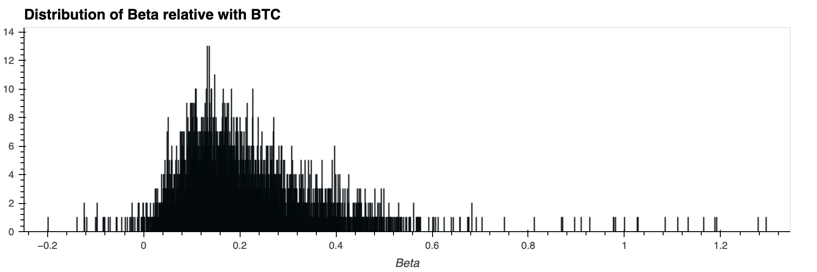
Titan Capital Management
Titan Capital Management
Data Cleanup & Exploration
Most securities have a low correlation to BTC
This means the portfolio that is highly correlated to BTC will have few stocks
Weekly Discussion
November 3rd, 2022
Weak Beta relationship of the stocks to BTC
Few stocks will behave similarly to BTC
5

Slide 6
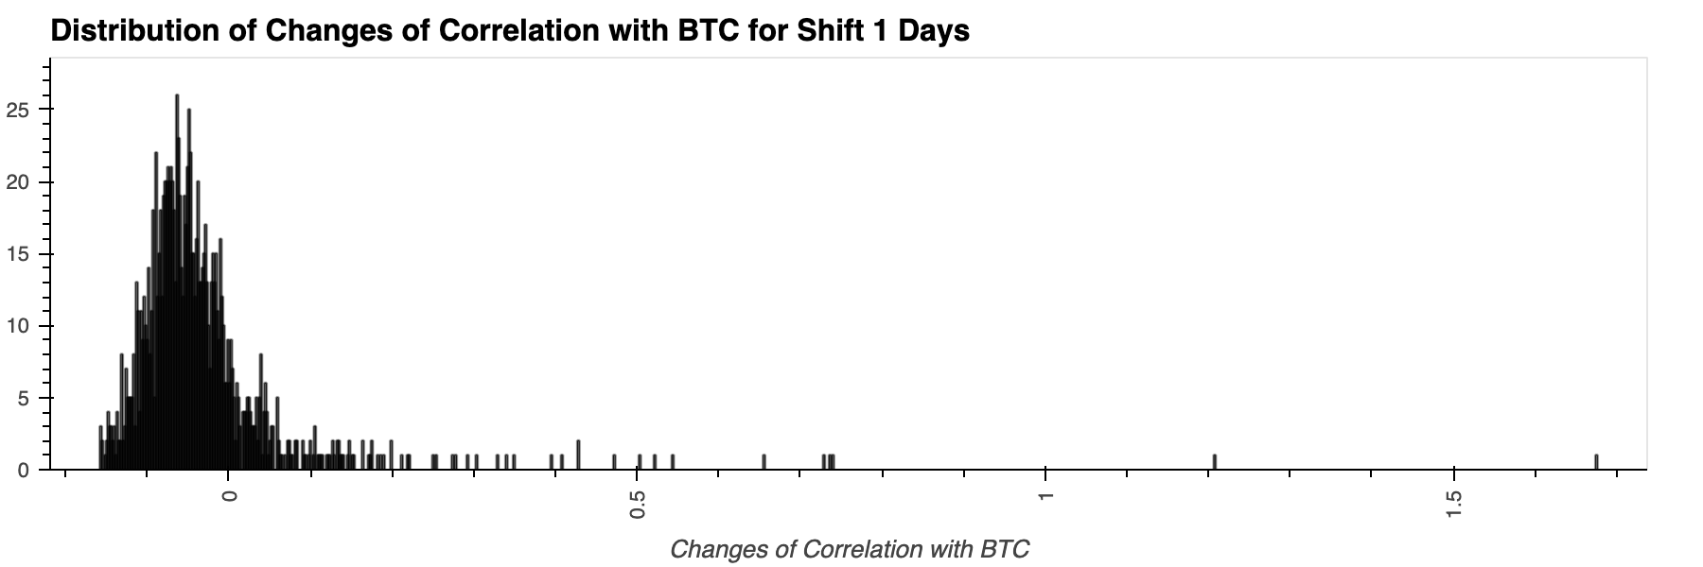
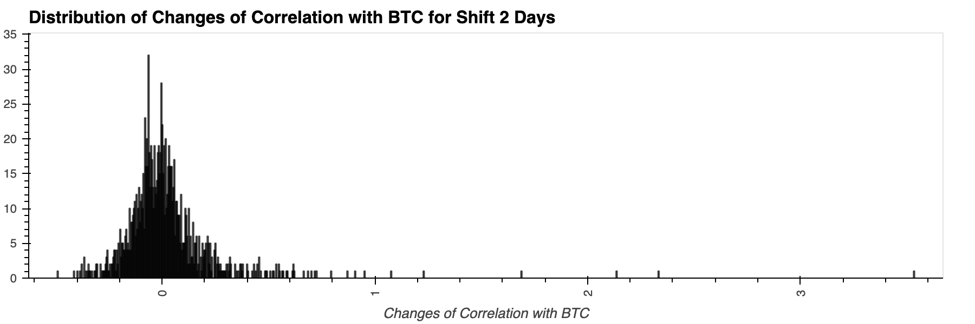
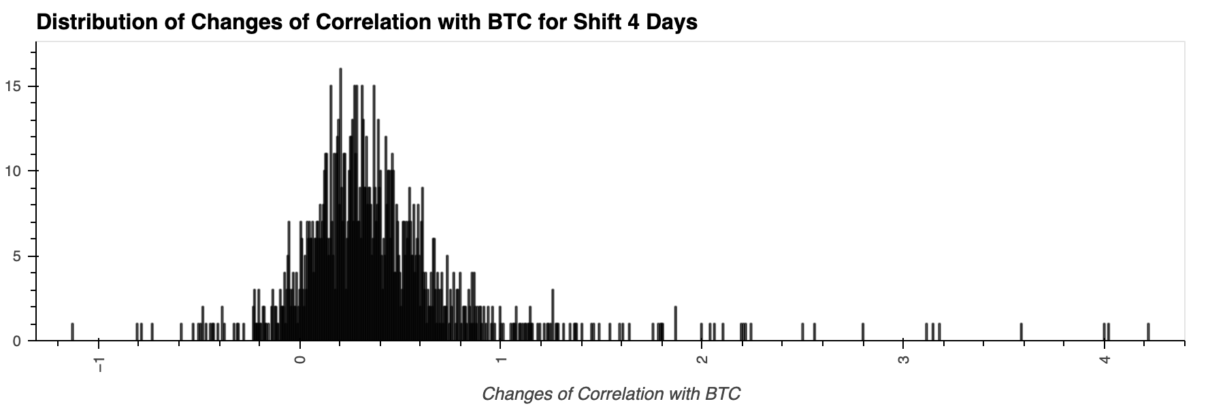
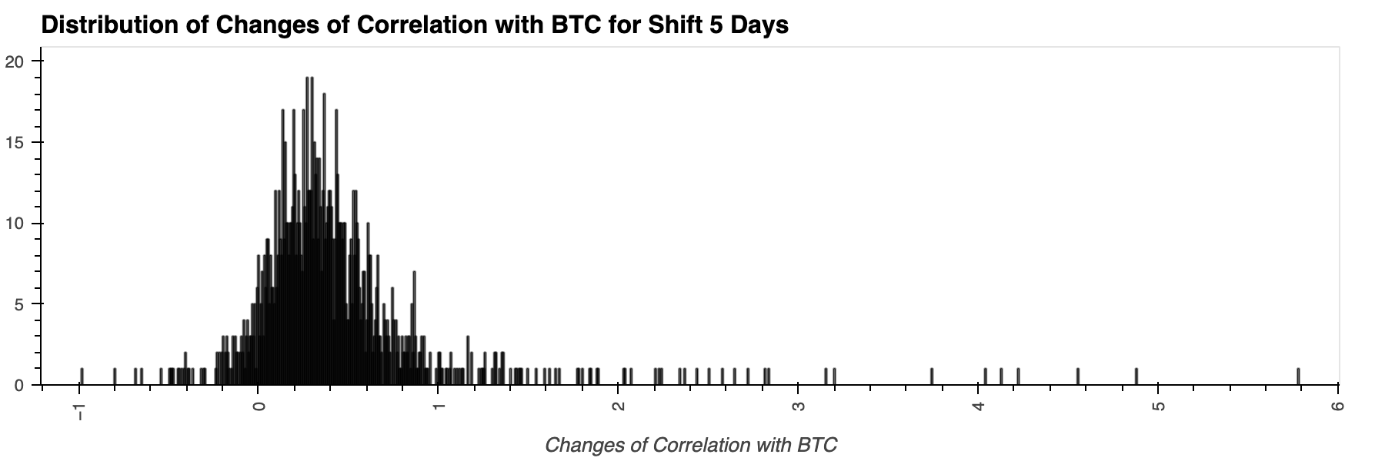
Titan Capital Management
Titan Capital Management
Data Cleanup & Exploration
Correlation increases significantly after a few days
Correlation begins to revert at day 5
6

Slide 7
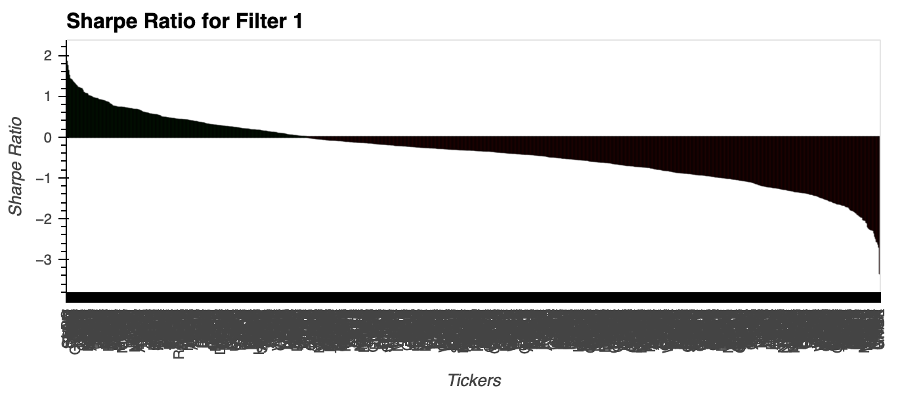
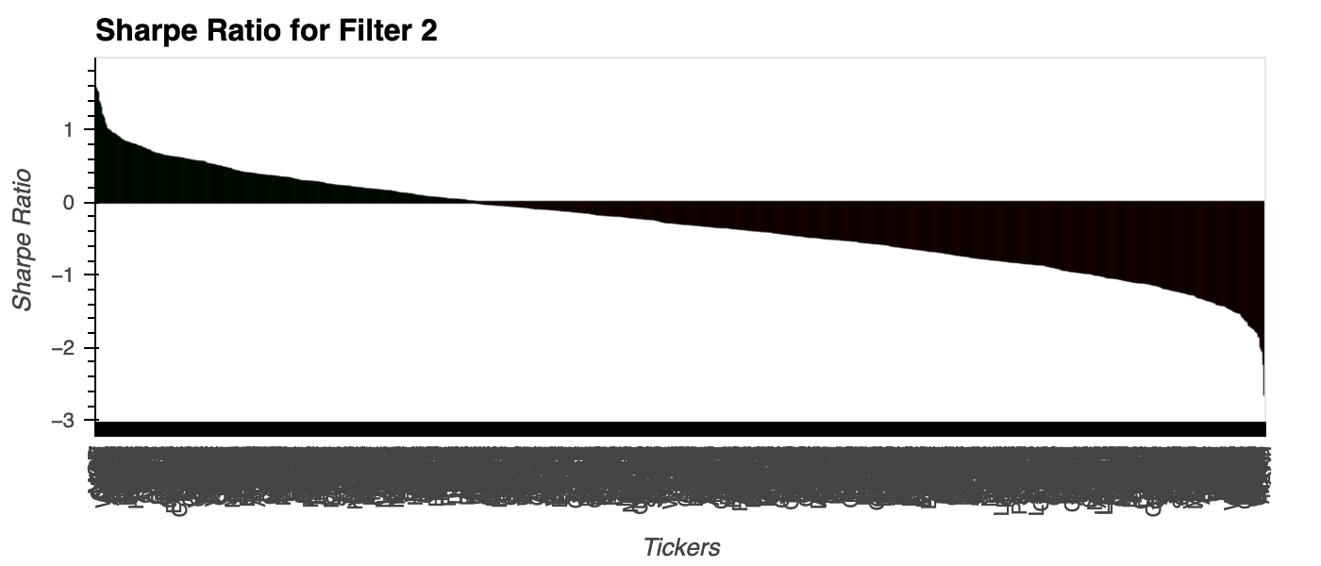
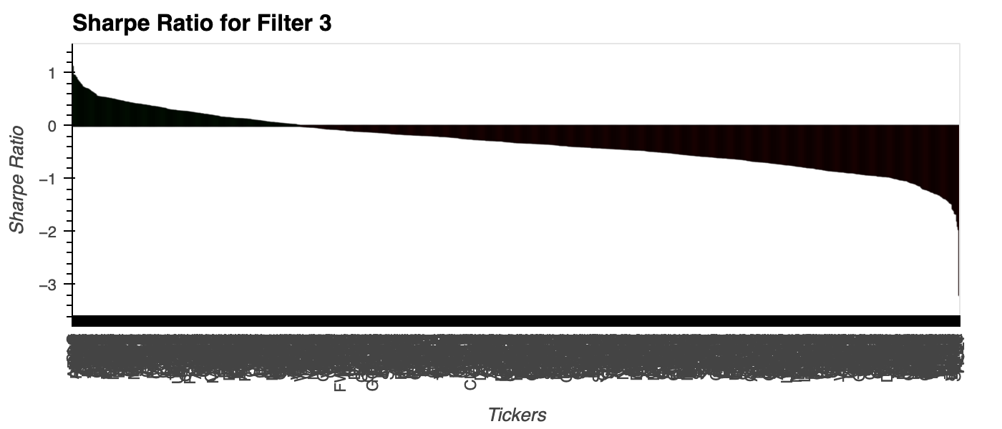
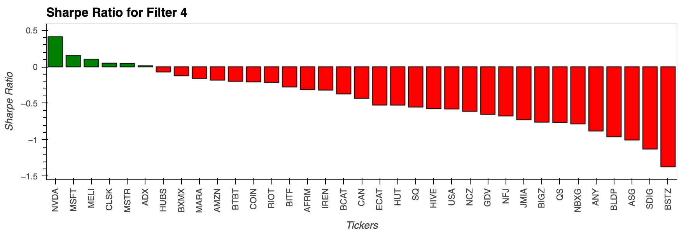
Titan Capital Management
Titan Capital Management
Data Analysis
First 1/3 Correlation to BTC
Second 1/3 Correlation to BTC
Last 1/3 Correlation to BTC
Top 1% Correlation to BTC
7
Notes:
Speaker: Phillip

Slide 8
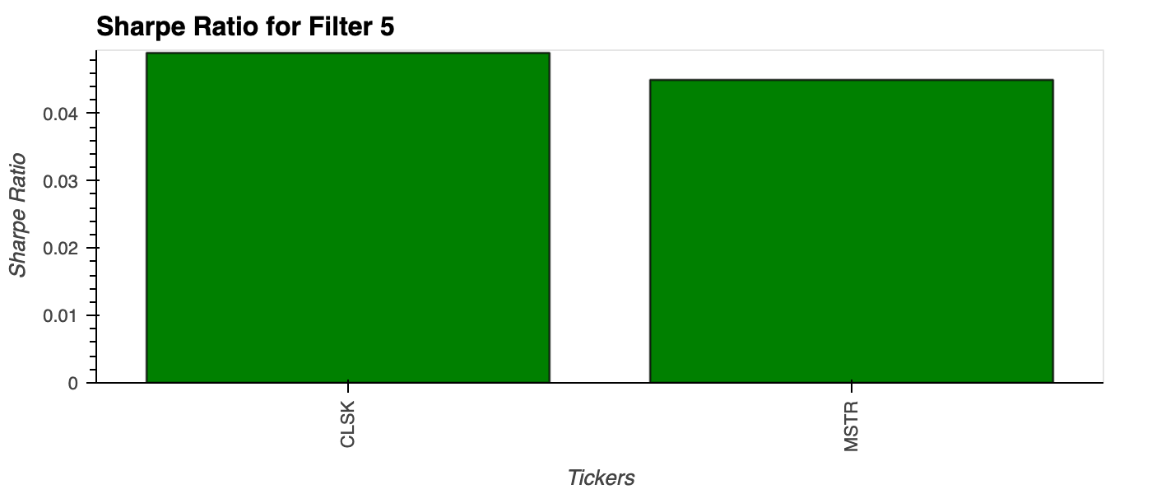
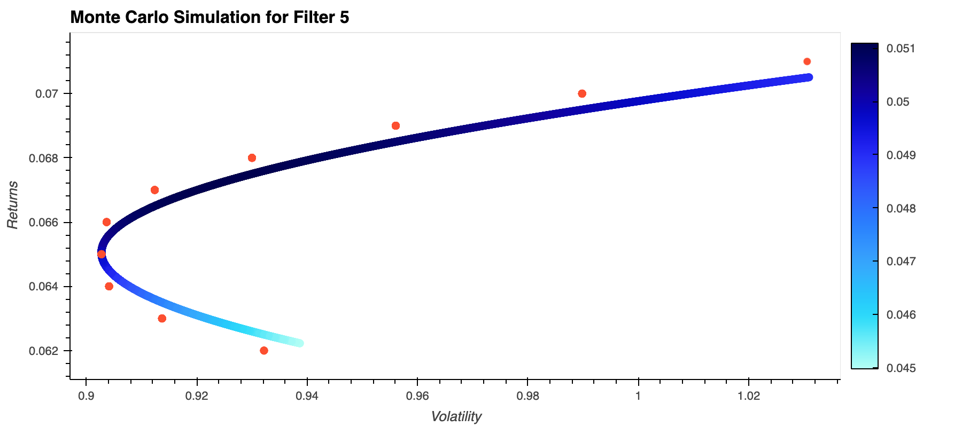
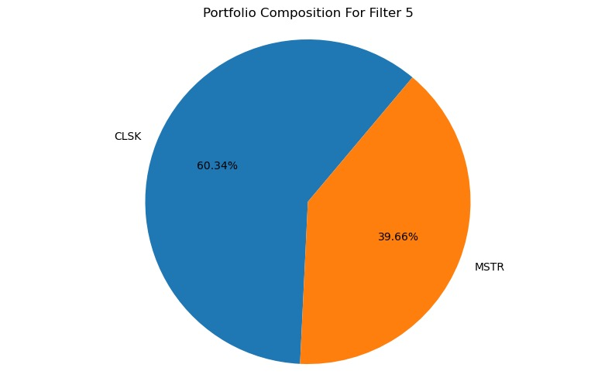
Titan Capital Management
Titan Capital Management
Data Analysis
Filter 5
Top 1% Beta of BTC
Sharpe ratio >= BTC’s
Weekly Discussion
November 3rd, 2022
8
Notes:
Speaker: Phillip

Slide 9
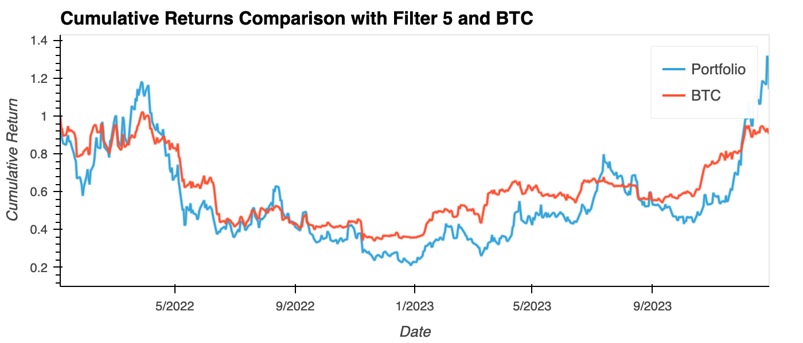
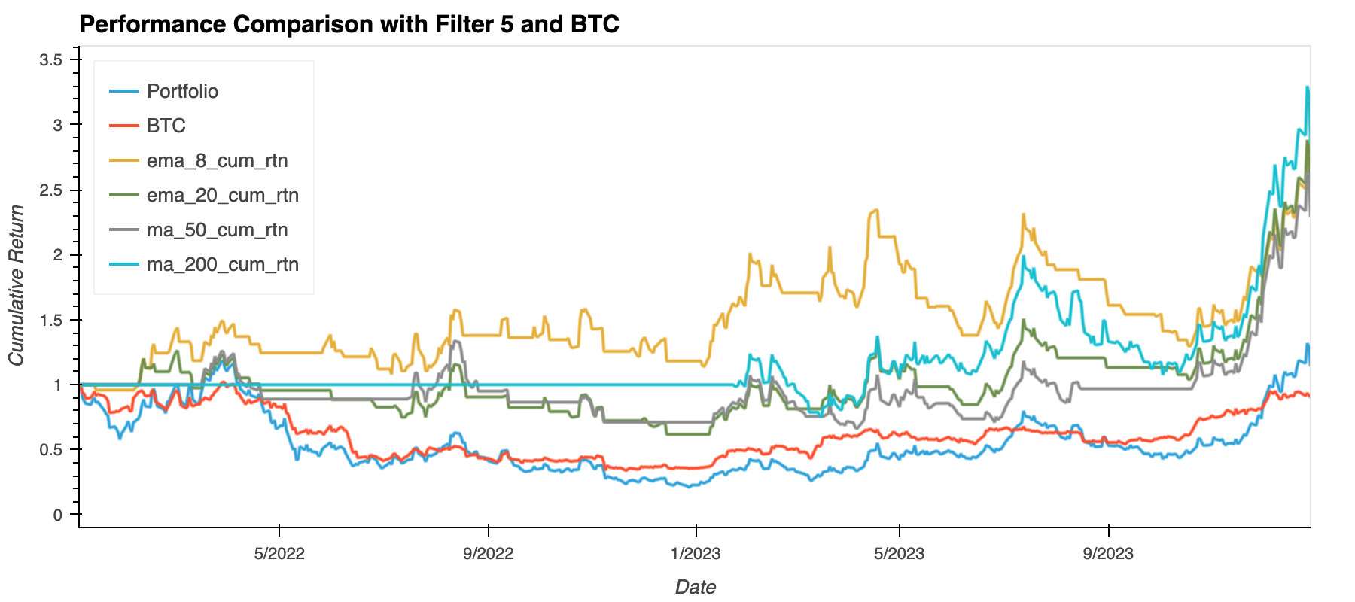
Titan Capital Management
Titan Capital Management
Data Analysis
Our portfolio emulated BTC returns on average
BTC avg daily returns = -0.02%; volatility = 56.97%
Portfolio avg daily returns = 0.03%; volatility = 92.43%
We took the portfolio returns and smoothed them
Strategy = sell when the portfolio returns fall below moving averages
Portfolio returns increase performance abundantly after using the strategy
9
Notes:
The portfolio also seemed to have higher volatility than BTC
So, we devised a trading strategy

Slide 10
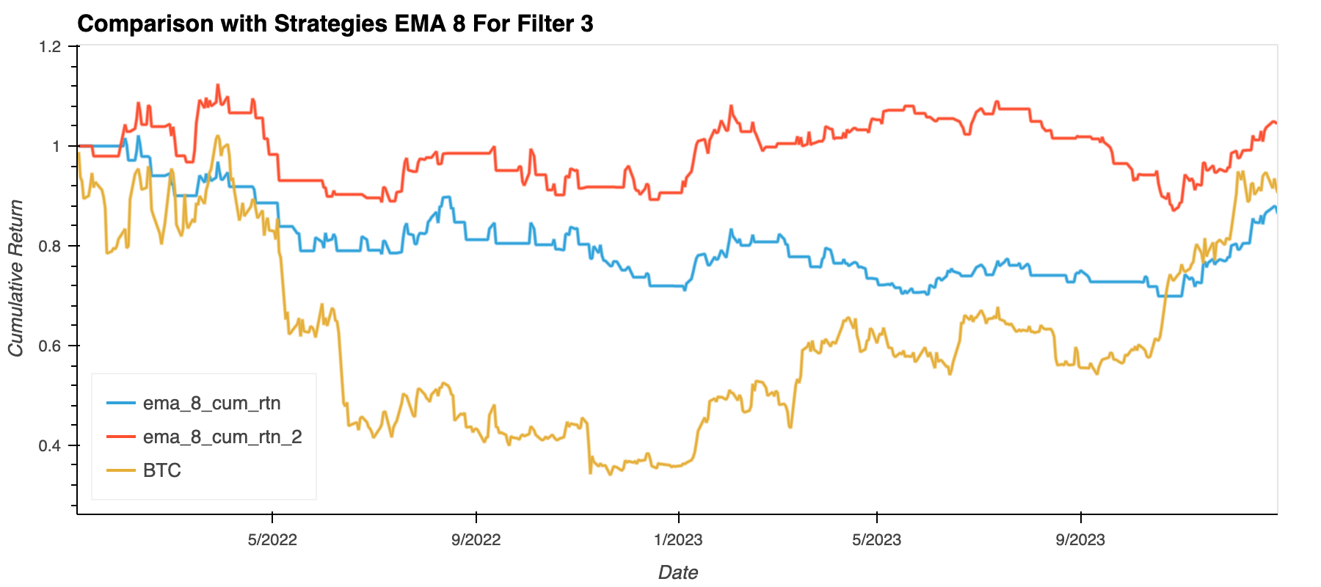
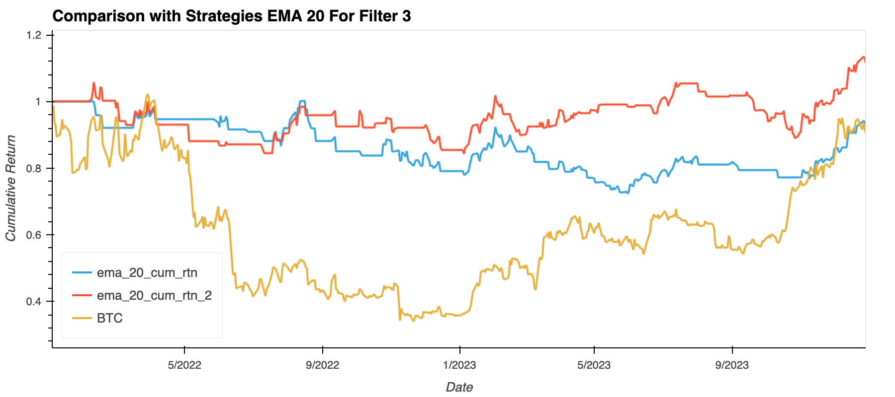
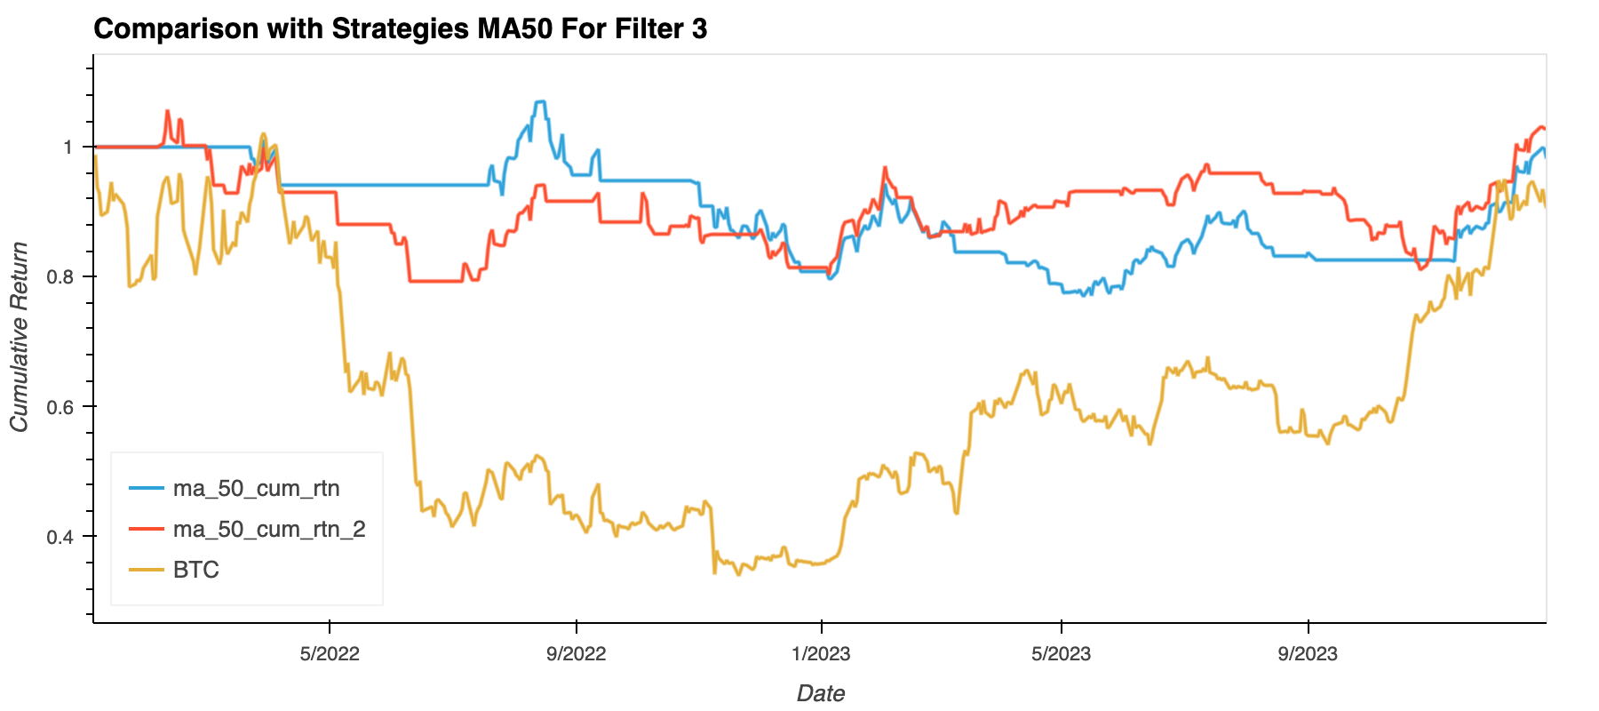
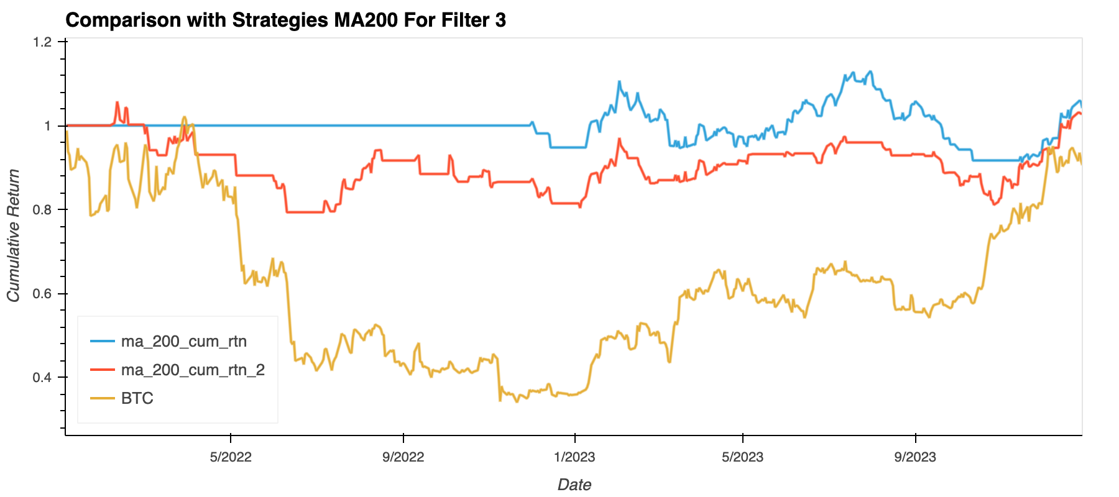
Titan Capital Management
Titan Capital Management
Data Analysis
10
Notes:
Speaker: Phillip

Slide 11
Titan Capital Management
Titan Capital Management
Discussion
Expectations:
Did not expect to have a 2-stock portfolio
Expected to see MARA & COIN to be a part of the final portfolio
Expected our portfolio to have less volatility than BTC
Weekly Discussion
November 3rd, 2022
General Conclusions:
We can construct a stock portfolio that behaves like BTC
BTC is a leading indicator in the short-term
11
Notes:
Speaker: Phillip

Slide 12
Titan Capital Management
Titan Capital Management
Postmortem
If we had more time, we would like to know:
Choose different timeframe to analyze the data
Why did some stocks like MARA & COIN did not make the portfolio
Focus on BTC volume; we think volume can be a leading indicator
How would portfolio performance look if we analyzed Beta too
How would our analysis change if we used the same 4 time periods for EMA & SMA alike
12
Notes:
Speaker: Phillip

Slide 13
UC Berkeley FinTech Bootcamp
Thank You！ Q&A?
Notes:
Speaker: Phillip

